Slide 1


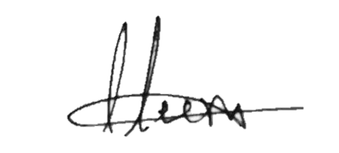
S.NO: ISM/IT/
INTERNATIONAL SCHOOL OF MANAGEMENT
Affiliated to Aryabhatta Knowledge University, Patna
CERTIFICATE
This is to certify that
of
has participated in the entitled
on
Head of Department
IQAC Coordinator

